Slide 1


A more precise statement of the Ergodic hypothesis
Thermodynamics offers two equivalent ways to think about averages:
Follow one molecule over time
Take a snapshot of a bunch of molecules at a given instant
Asserting the equivalence of #1 and #2 is the precise formulation of the ergodic hypothesis.
$<v>_{time}$
$<v>_{particles}$

Slide 2
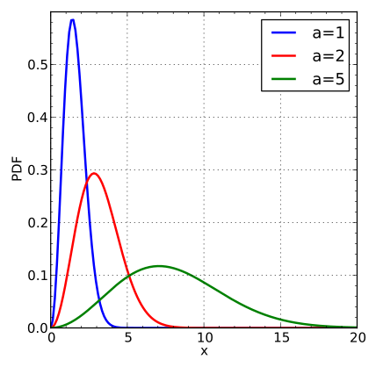
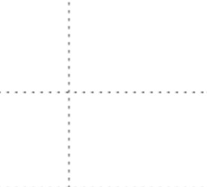
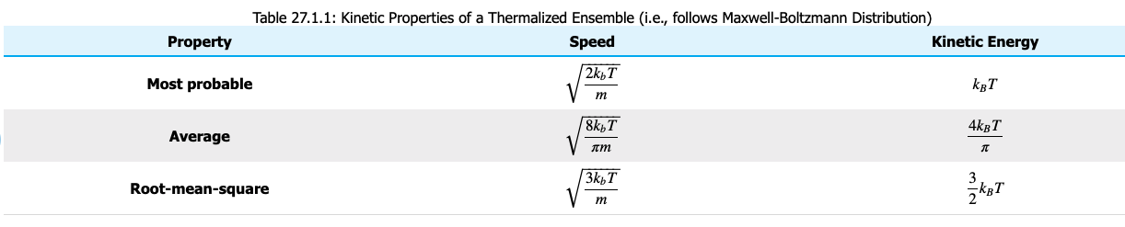


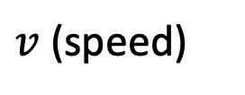
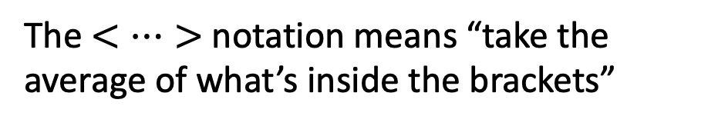



Recap of probability distributions and the three c’s
$$f_{M}$$
$$c^{∗}$$
$$\overline{c}= <v>$$
$$c= <v^{2}>^{1/2}$$
The $<…>$notation means “take the average of what’s inside the brackets”
$v$ (speed)
$c^{∗}<\overline{c}<c$

Slide 3
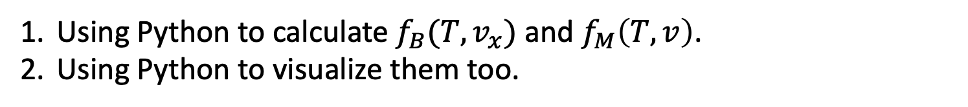
What we’re up to today
Using Python to calculate $f_{B}(T,v_{x})$ and $f_{M}\left(T,v\right)$.
Using Python to visualize them too.

Slide 4
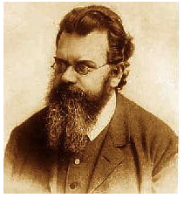
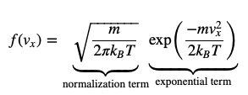
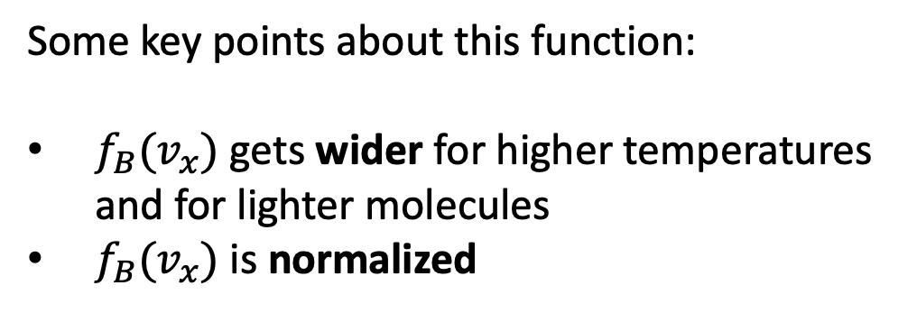

The Boltzmann Distribution (which we’re calling “$f_{B}$”)
Our notation:
$$f_{B}=N_{B}\exp\left(−Dv_{x}^{2}\right)$$
$${N_{B}=\left(\frac{M}{2πRT}\right)}^{\frac{1}{2}}$$
$$D=\frac{M}{2RT}$$
Some key points about this function:
$f_{B}(v_{x})$ gets wider for higher temperatures and for lighter molecules
$f_{B}(v_{x})$ is normalized

Slide 5
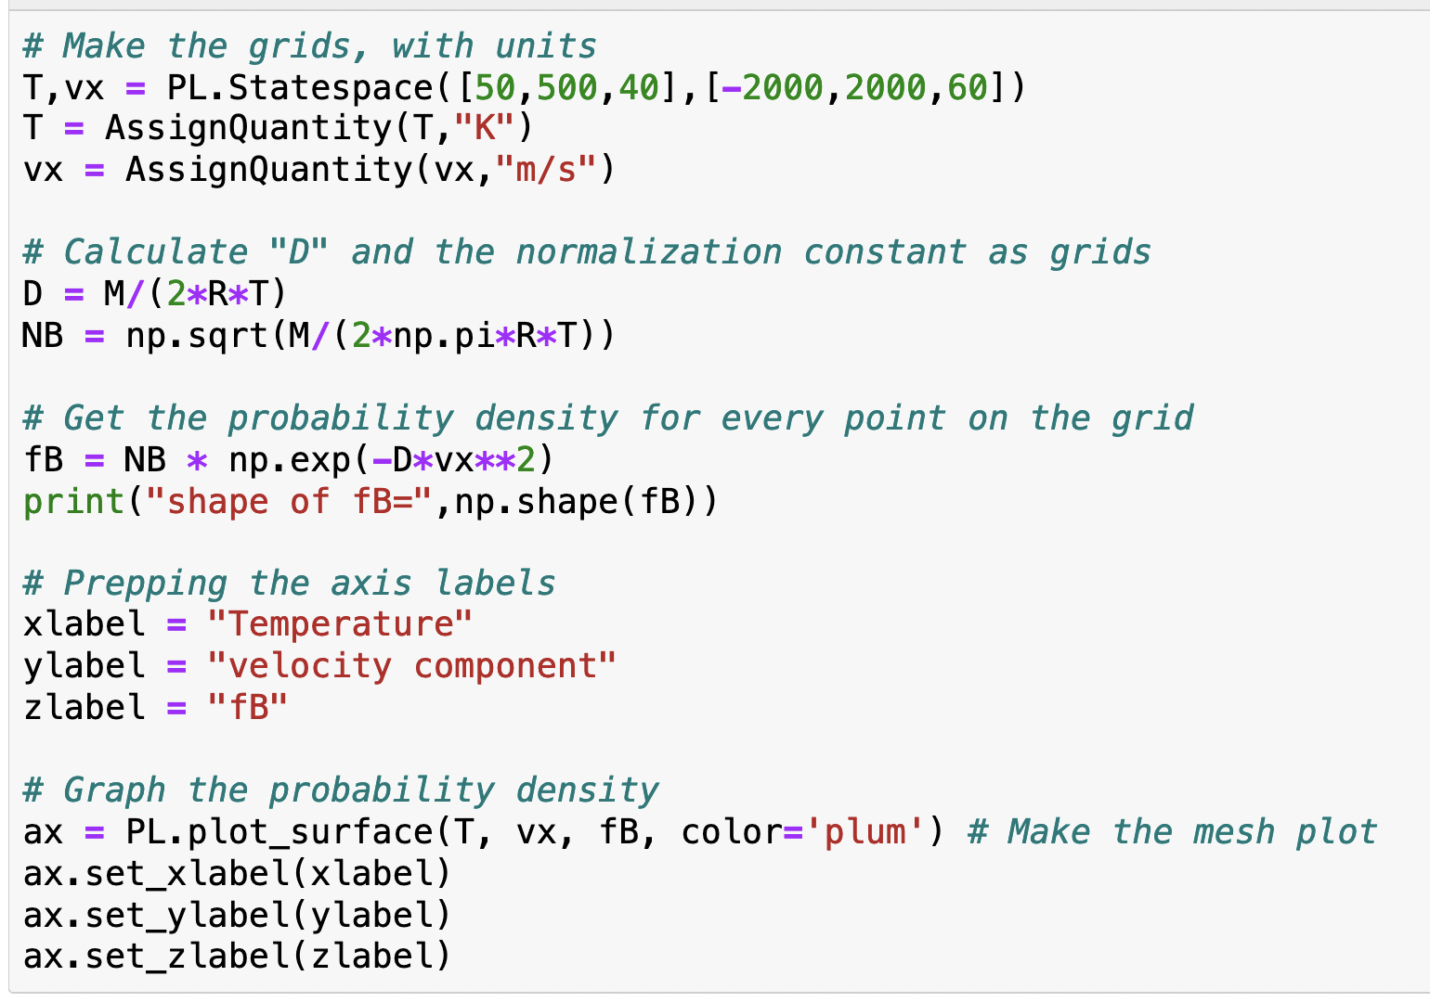
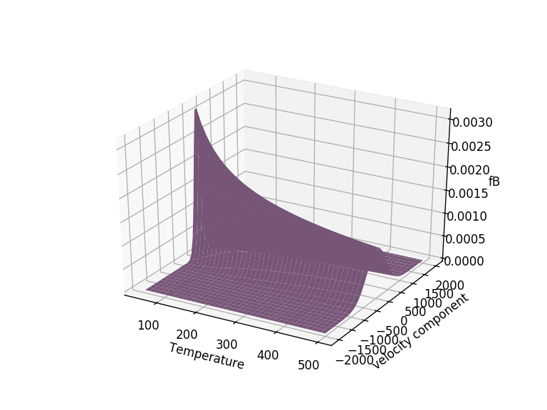
Using Python to visualize $f_{B} (T,v_{x})$ (grid)

Slide 6
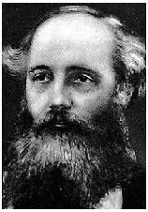

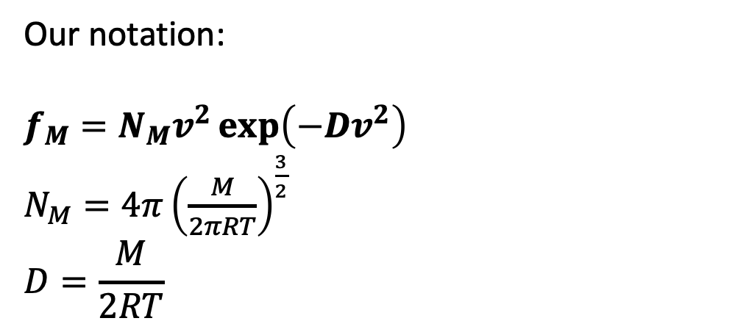
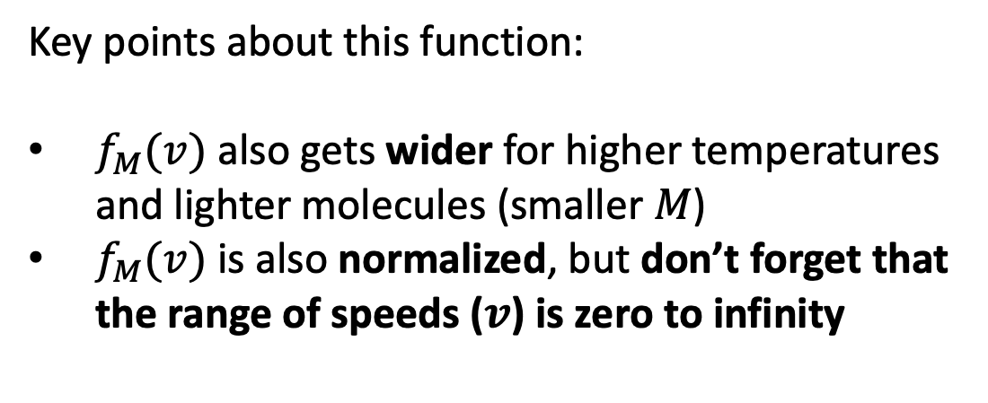
The Maxwell Distribution (which we’re calling “$f_{M}$”)
Our notation:
$$f_{M}=N_{M}v^{2}\exp\left(−Dv^{2}\right)$$
$N_{M}=4π{\left(\frac{M}{2πRT}\right)}^{\frac{3}{2}}$
$$D=\frac{M}{2RT}$$
Key points about this function:
$f_{M}(v)$ also gets wider for higher temperatures and lighter molecules (smaller $M$)
$f_{M}(v)$ is also normalized, but don’t forget that the range of speeds ($v$) is zero to infinity

Slide 7
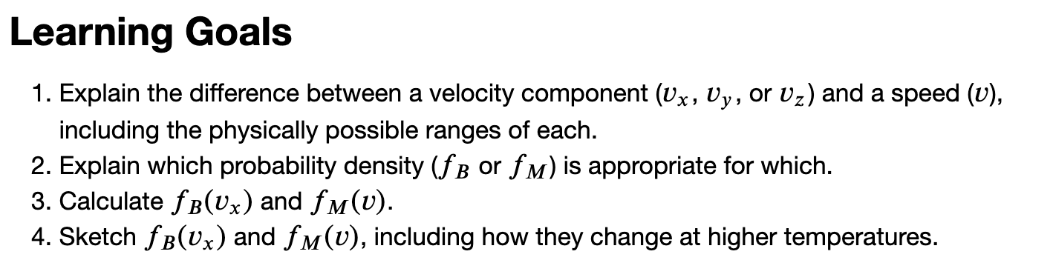

Slide 8
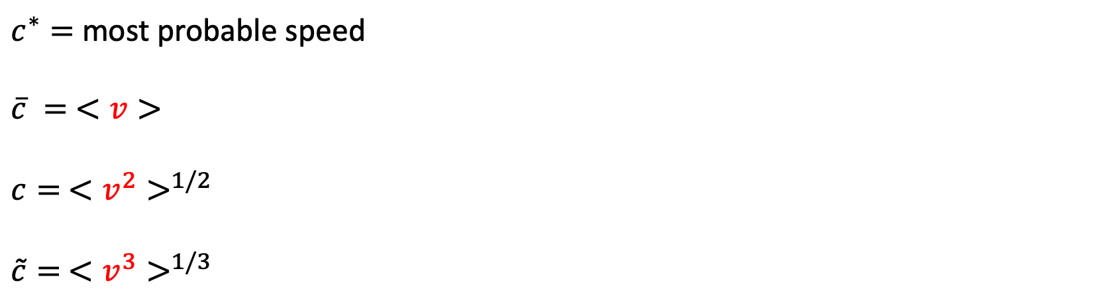

Speeds and averages
$$f_{M}$$
$c^{∗}=$ most probable speed
$\overline{c} = <v>$
$c= <v^{2}>^{1/2}$
$\tilde{c}= <v^{3}>^{1/3}$
$v$ (speed)
$$c^{∗}<\overline{c}<c<\tilde{c}$$

Slide 9





A third way to calculate averages: probability-weighted averaging
Before, we talked about computing averages by
Following one molecule over time, or
Averaging a bunch of molecules at an instant in time.
$<v>_{time}$
$<v>_{particles}$
Here, we’re going to use yet a third way, in which we weight each speed by its probability. Let’s see if we can attach some intuition to this approach.
$$f_{M}$$
$<v>_{probability}$
$$v$$

Slide 10
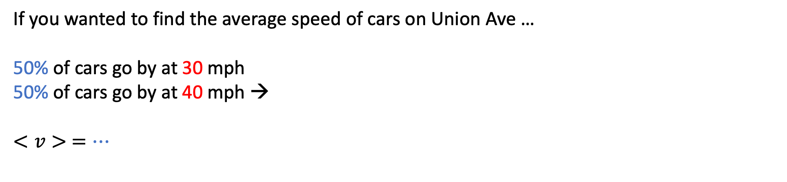
Probability-weighted averaging – cars passing by
If you wanted to find the average speed of cars on Union Ave …
50% of cars go by at 30 mph
50% of cars go by at 40 mph →
$<v> =…$

Slide 11
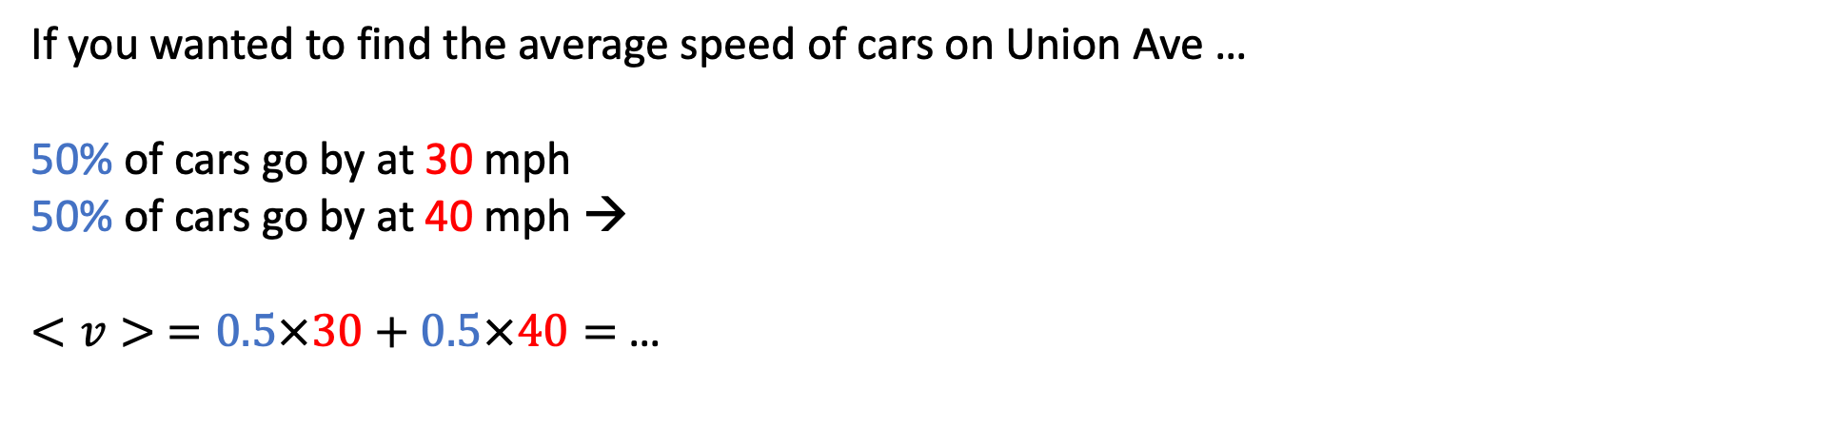
Probability-weighted averaging – cars passing by
If you wanted to find the average speed of cars on Union Ave …
50% of cars go by at 30 mph
50% of cars go by at 40 mph →
$<v> =0.5×30+0.5×40=$…

Slide 12
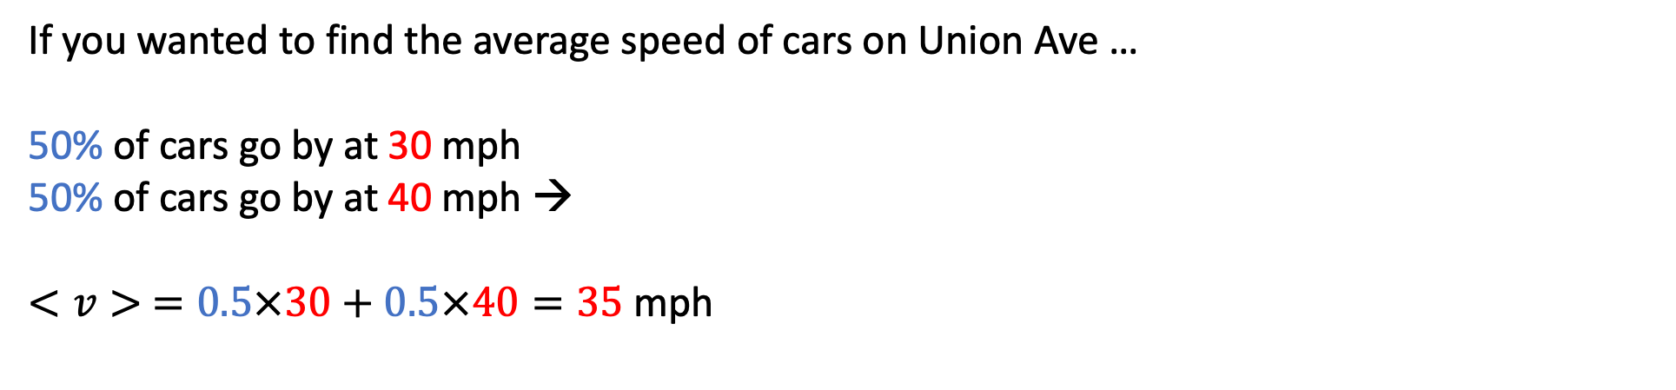
Probability-weighted averaging – cars passing by
If you wanted to find the average speed of cars on Union Ave …
50% of cars go by at 30 mph
50% of cars go by at 40 mph →
$<v> =0.5×30+0.5×40=35$mph

Slide 13
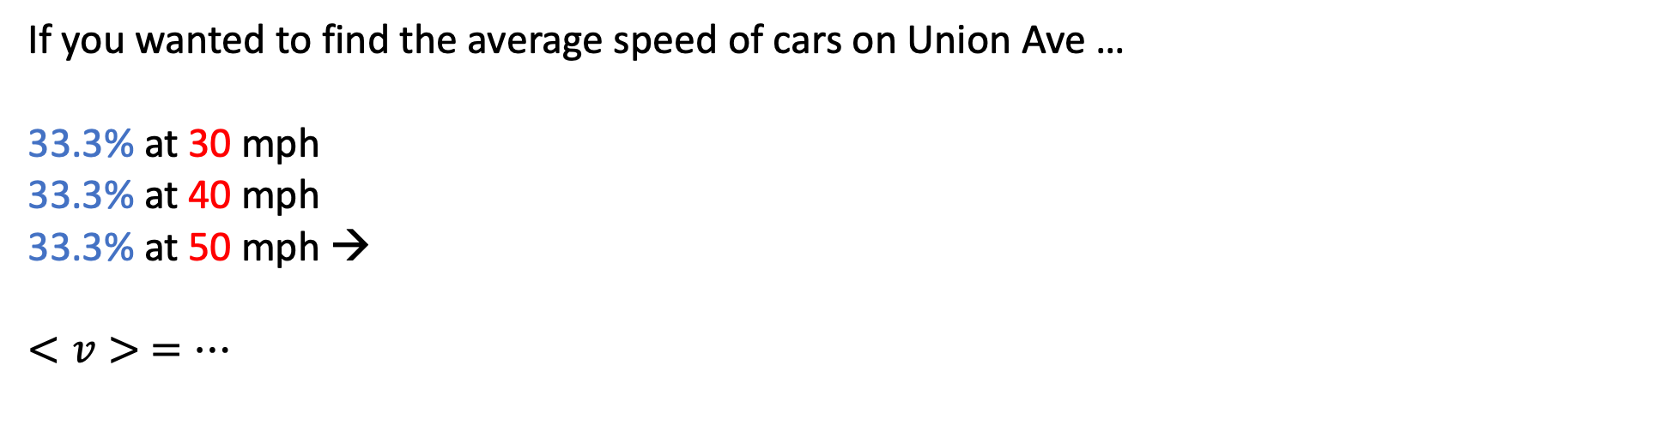
Probability-weighted averaging – cars passing by
If you wanted to find the average speed of cars on Union Ave …
33.3% at 30 mph
33.3% at 40 mph
33.3% at 50 mph →
$<v> =…$

Slide 14
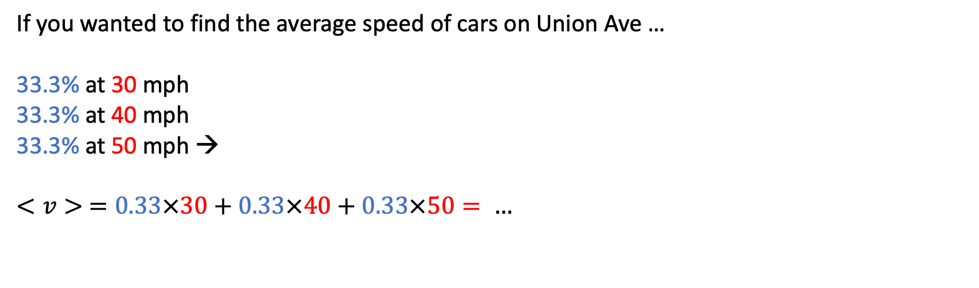
Probability-weighted averaging – cars passing by
If you wanted to find the average speed of cars on Union Ave …
33.3% at 30 mph
33.3% at 40 mph
33.3% at 50 mph →
$$<v> =0.33×30+0.33×40+0.33×50= …$$

Slide 15
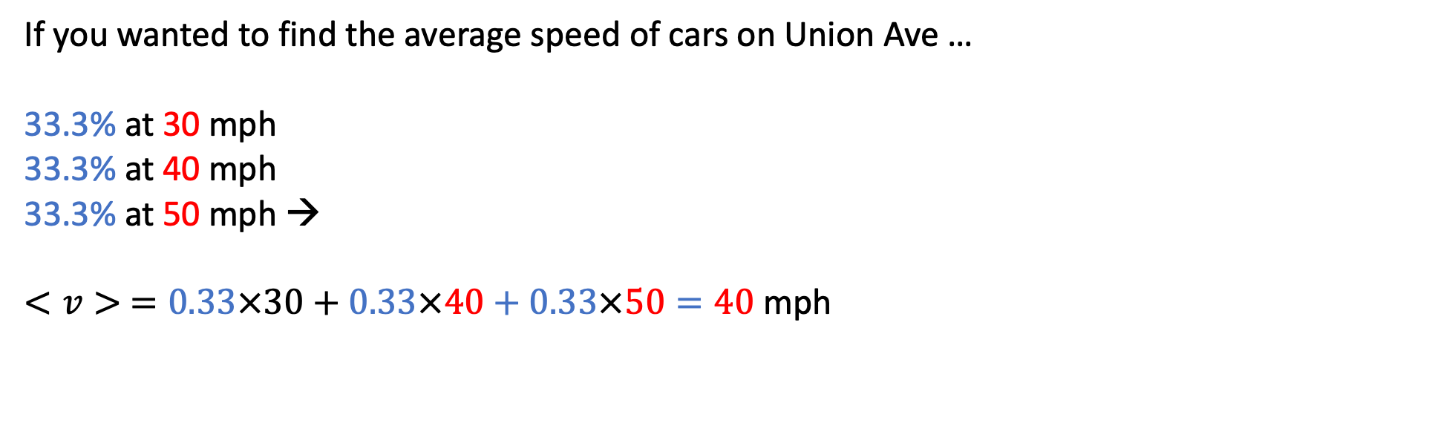
Probability-weighted averaging – cars passing by
If you wanted to find the average speed of cars on Union Ave …
33.3% at 30 mph
33.3% at 40 mph
33.3% at 50 mph →
$$<v> =0.33×30+0.33×40+0.33×50=40 \text{mph}$$

Slide 16
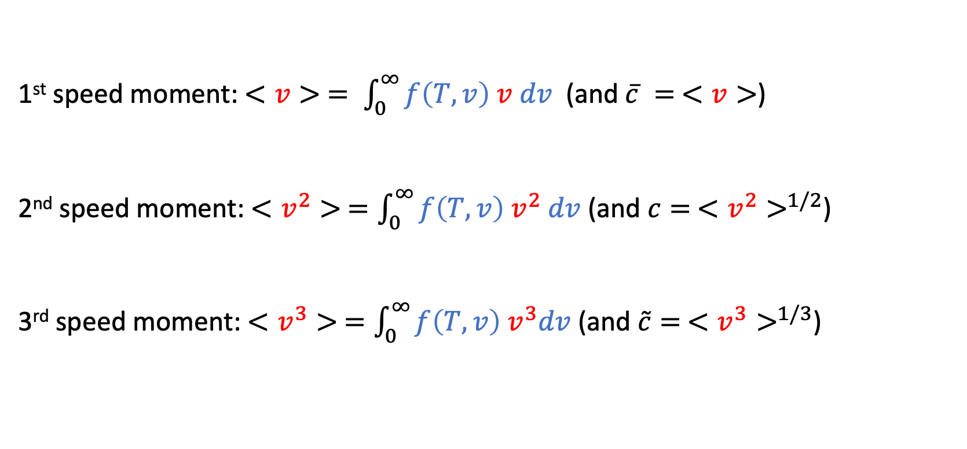
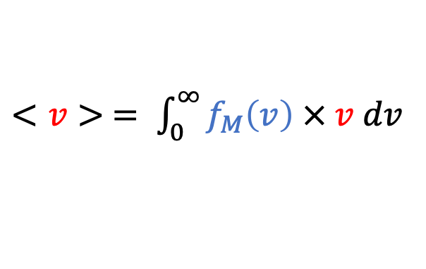
Probability-weighted averaging yields “speed moments”
$<v> = \int_{0}^{∞}{f_{M}\left(v\right) × v dv}$
probability density
speed
1st speed moment: $<v> = \int_{0}^{∞}{f\left(T,v\right) v dv}$ (and $\overline{c} = <v>$)
2nd speed moment: $<v^{2}> =\int_{0}^{∞}{f\left(T,v\right) v^{2} dv}$ (and $c= <v^{2}>^{1/2}$)
3rd speed moment: $<v^{3}> =\int_{0}^{∞}{f\left(T,v\right){ v}^{3}dv}$ (and $\tilde{c}= <v^{3}>^{1/3}$)

